Slide 1

Cloud Solution Architect
Module 2
Lecture 2
Introduction to Linux Operating System and Virtualization

Slide 2
Recap
Module 1 - Lecture 1
Introduction to Cloud Computing
IaaS, PaaS, SaaS, On-Prem

Slide 3
Learning Objectives
Module 2 - Lecture 2
Introduction to Linux
Linux Kernel
Introduction to Virtualization
Virtual Machines
Hypervisors
OS installation on Virtual Machine
Ubuntu Graphical User Interface (GUI)

Slide 4

First of multitasking, a multiuser operating system
Development started in 1969 by AT&T at Bell Labs research center by Ken Thompson and Dennis Ritchie.

Slide 5
Development stared in 1969 by AT&T at Bell Labs research center by Ken Thompson and Dennis Ritchie.
First of multitasking, multiuser operating system.

Slide 6
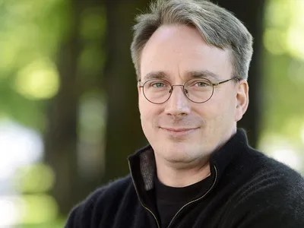

Linus Torvalds
Free Software Foundation
Linux was created in the early 1990s by Finnish software engineer Linus Torvalds and the Free Software Foundation (FSF). Linus started developing Linux to create a system similar to MINIX, a UNIX like Operating System.

Slide 7
Modern, free operating system based on UNIX
the self-contained kernel in 1991
Unix Compatibility
many users around the world are its collaborators
runs efficiently and reliably on common PC hardware
runs on other platforms like raspberry pi, IoT devices

Slide 8
Series of widely used free software licenses that guarantee end-users the four freedoms to: run, study, share and modify the software

Slide 9
GNU General Public License (GNU GPL)
Series of widely used free software licenses that guarantee end-users the four freedoms to: run, study, share and modify the software

Slide 10
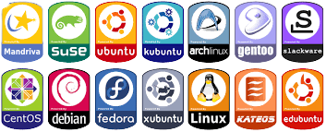
Linux Distributions
and 1200+ more

Slide 11
Major Linux Distributions
RedHat Enterprise Linux: https://www.redhat.com/
Debian: https://www.debian.org/
Ubuntu: https://ubuntu.com/
Fedora Core: https://getfedora.org/
CentOS: https://www.centos.org/
Kali Linux: https://www.kali.org/

Slide 12
Major Linux Distributions
RedHat Enterprise Linux: PC, server, hypervisors, cloud
Debian: laptops, PC, servers
Ubuntu: laptops, PC, servers, hypervisors, cloud, IoT
Fedora Core: laptops, PC, servers
CentOS: servers, cloud, hypervisor
Kali Linux: Penetration testing, laptop, pc

Slide 13
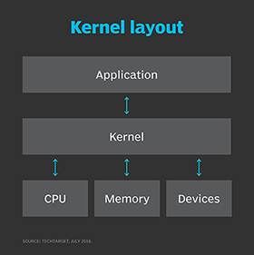
Kernel
The main layer between the OS and hardware.
Helps with process and memory management, file systems, device control, and networking.

Slide 14
Linux Kernel
Version 0.01 (May 1991) had no networking, ran only on 80386-compatible Intel processors and on PC hardware, had extremely limited device-drive support, and supported only the Minix file system
Linux 1.0 (March 1994) included these new features:
Support for UNIX’s standard TCP/IP networking protocols
BSD-compatible socket interface for networking programming
Device-driver support for running IP over an Ethernet

Slide 15
Linux Kernel
Enhanced file system
Support for a range of SCSI controllers for
high-performance disk access
Extra hardware support
Version 1.2 (March 1995) was the final PC-only Linux kernel
Kernels with odd version numbers are development kernels, those with even numbers are production kernels

Slide 16
Linux Kernel
Released in June 1996, 2.0 added two major new capabilities:
Support for multiple architectures, including a fully 64-bit native Alpha port
Support for multiprocessor architectures
Other new features included:
Improved memory-management code
Improved TCP/IP performance
Support for internal kernel threads, for handling dependencies between loadable modules, and for automatic loading of modules on demand

Slide 17
Linux Kernel
Standardized configuration interface
Available for Motorola 68000-series processors, Sun Sparc systems, and for PC and PowerMac systems
2.4 and 2.6 increased SMP support, added journaling file system, preemptive kernel, 64-bit memory support
3.0 released in 2011, the 20th anniversary of Linux, improved virtualization support, a new page write-back facility, improved memory management, new Completely Fair Scheduler

Slide 18
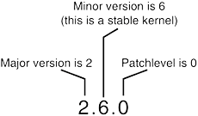
Understanding Kernel Versions

Slide 19
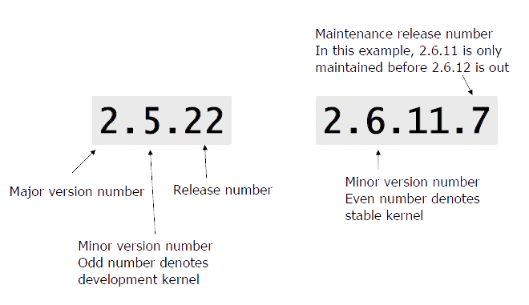
Understanding Kernel Versions

Slide 20
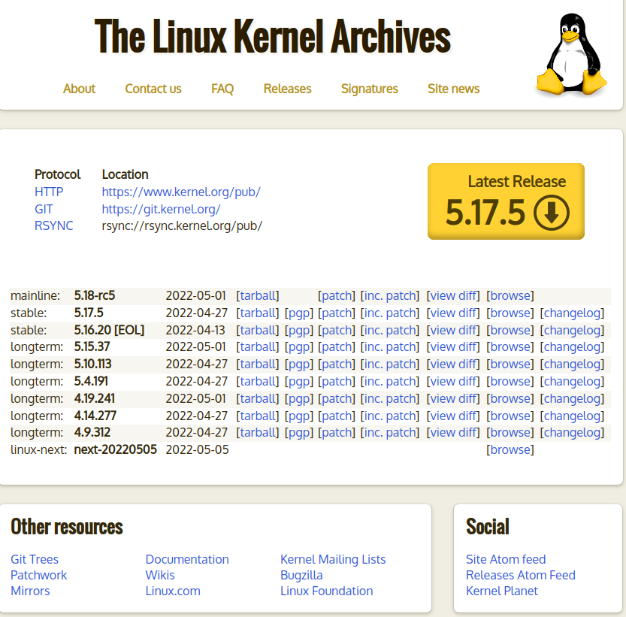
Download Linux Kernel
https://kernel.org

Slide 21
Virtualization
Creation of a virtual version of something
Simulates hardware functionality to create a virtual system

Slide 22
Virtual Machine
Virtualization/emulation of a computer system
Based on computer architectures
Provide functionality of a physical computer
implementations may involve specialized hardware, software, or a combination.

Slide 23
System Virtual Machine
Provide a substitute for a real machine

Slide 24
Process Virtual Machine
Designed to execute computer programs in a platform-independent environment.

Slide 25
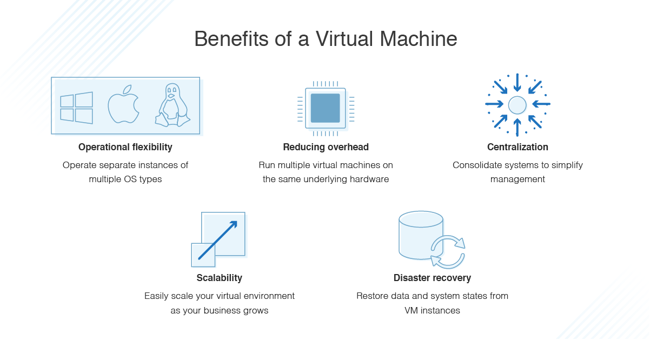

Slide 26
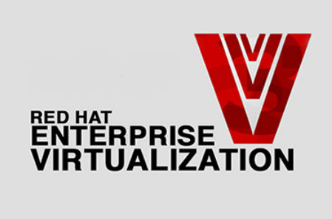

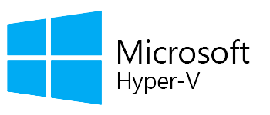


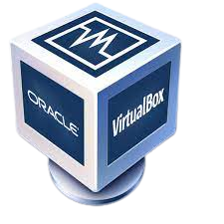
Hypervisor
Software that creates and runs a virtual machine

Slide 27
Type 1 Hypervisor
runs directly on the underlying computer's physical hardware, interacting directly with its CPU, memory, and physical storage

Slide 28
Type 2 Hypervisor
virtual machine (VM) manager that is installed as a software application on an existing operating system (OS)

Slide 29
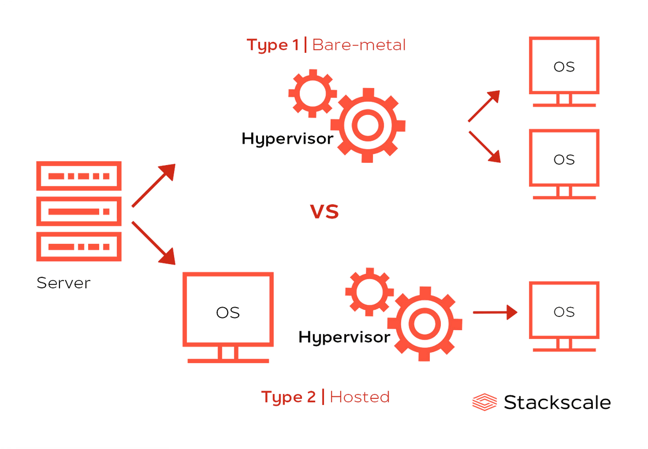
Type 1 vs Type 2 Hypervisors
Type 1 runs on bare metal and Type 2 runs on top of an operating system.

Slide 30
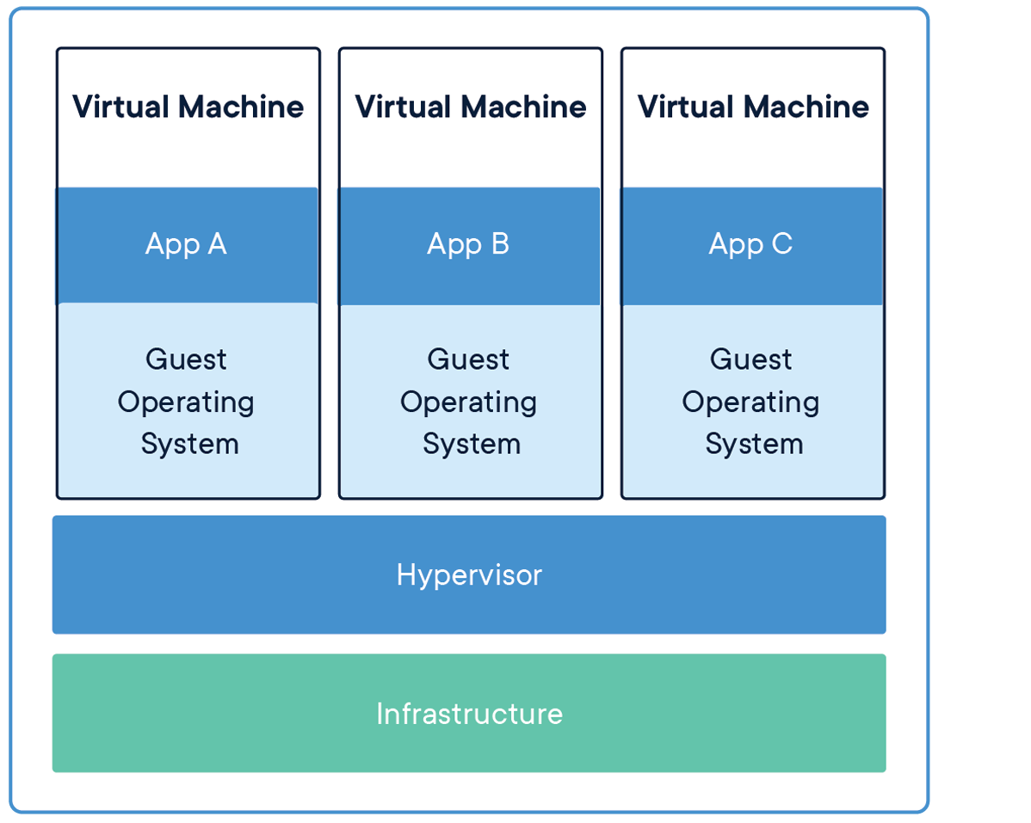

Slide 31
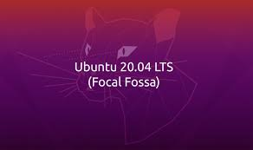
Ubuntu Linux Installation
Installing Ubuntu Desktop 20.04 Ubuntu

Slide 32
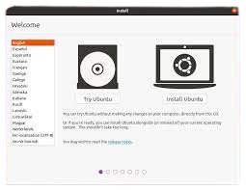
Ubuntu Linux Installation
Installing Ubuntu Desktop 20.04 Ubuntu

Slide 33
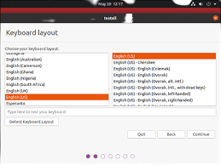
Ubuntu Linux Installation
Installing Ubuntu Desktop 20.04 Ubuntu

Slide 34
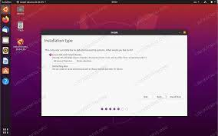
Ubuntu Linux Installation
Installing Ubuntu Desktop 20.04 Ubuntu

Slide 35
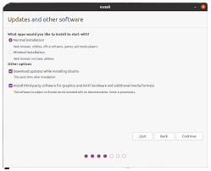
Ubuntu Linux Installation
Installing Ubuntu Desktop 20.04 Ubuntu

Slide 36
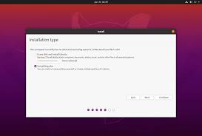
Ubuntu Linux Installation
Installing Ubuntu Desktop 20.04 Ubuntu

Slide 37
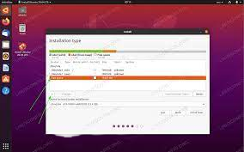
Ubuntu Linux Installation
Installing Ubuntu Desktop 20.04 Ubuntu

Slide 38
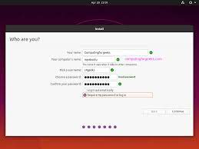
Ubuntu Linux Installation
Installing Ubuntu Desktop 20.04 Ubuntu

Slide 39
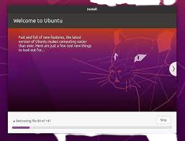
Ubuntu Linux Installation
Installing Ubuntu Desktop 20.04 Ubuntu

Slide 40
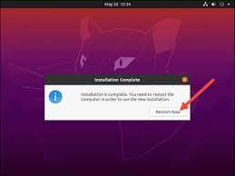
Ubuntu Linux Installation
Installing Ubuntu Desktop 20.04 Ubuntu

Slide 41
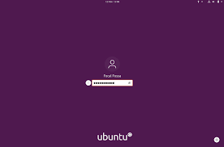
Ubuntu Linux Installation
Installing Ubuntu Desktop 20.04 Ubuntu

Slide 42
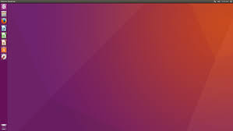
Ubuntu Linux Installation
Graphical User Interface

Slide 43
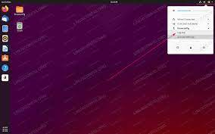
Ubuntu Linux Installation
Graphical User Interface

Slide 44
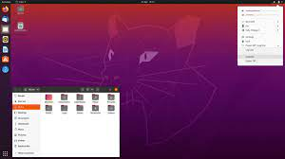
Ubuntu Linux Installation
Graphical User Interface

Slide 45
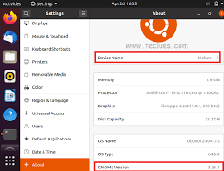
Ubuntu Linux Installation
Graphical User Interface

Slide 46
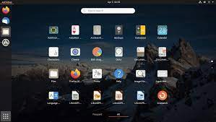
Ubuntu Linux Installation
Graphical User Interface

Slide 47
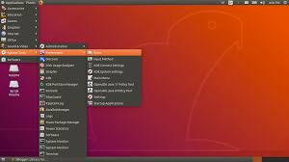
Ubuntu Linux Installation
Graphical User Interface

Slide 48
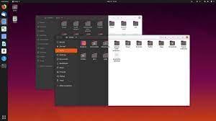
Ubuntu Linux Installation
Graphical User Interface

Slide 49
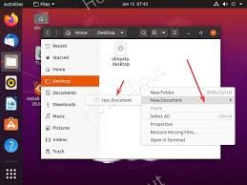
Ubuntu Linux Installation
Graphical User Interface

Slide 50
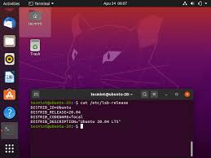
Ubuntu Linux Installation
Graphical User Interface

Slide 51
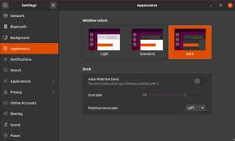
Ubuntu Linux Installation
Graphical User Interface

Slide 52
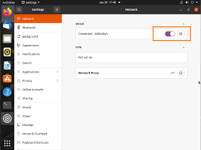
Ubuntu Linux Installation
Graphical User Interface

Slide 53
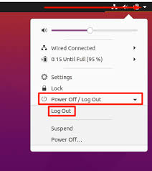
Ubuntu Linux Installation
Graphical User Interface

Slide 54
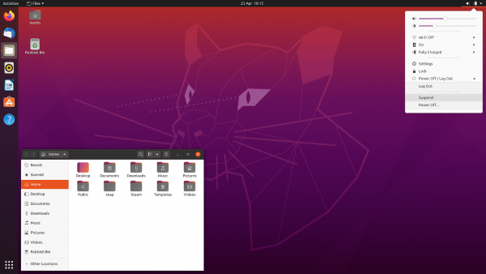

Slide 55
Summary
Module 2 - Lecture 1
Introduction to Linux (Ubuntu)
Linux Kernel
Introduction to Virtualization
Virtual Machines
Hypervisors
OS installation on Virtual Machine
Ubuntu Graphical User Interface (GUI)

Slide 56
Next Lecture
Module 2 - Lecture 3
Introduction to Command Line Interface (CLI)
Linux directory structure
Basic Linux Commands

Slide 57

Ask Questions!!

